Slide 1
Professional JavaScript for
Web Development
Chapter-8 :The Browser Object Model
PRESENTED BY:
DAW SAW THANDAR SHWE
LECTURER
ITSM DEPARTMENT
UNIVERSITY OF COMPUTER STUDIES (SITTWAY)
Information Technology Supporting and Maintenance

Slide 2
Outlines
The window object
Information Technology Supporting and Maintenance

Slide 3
The Browser Object Model(BOM)
is used to interact with the browser.
provides access to the various characteristics of a browser (Browser window itself, Screen characteristics, Browser history etc…..
By using BOM, can modify, move the window or can change the text in status bar, read the current URL, go back or forward of the current page.
Information Technology Supporting and Maintenance

Slide 4
The Window Object
is supported by all browsers.
represents the browser's window.
All global JavaScript objects, functions and variables automatically become members of the window object.
Global variables are properties of the window object.
Global functions are methods of the window object.
Information Technology Supporting and Maintenance

Slide 5
The Global Scope
A variable named age and a function named sayAge() are defined in the global scope, which automatically places them on the window object.
Eg:
  var age=29;
  function sayAge(){
  alert(this.age);
  }
  alert(window.age);//29
  sayAge();//29
  window.sayAge();//29
Information Technology Supporting and Maintenance

Slide 6
Window Relationships and Frames
If a page contain frames, each frame has its own window object and is stored in the frames collection.
Within the frames collection, the window objects are indexed both by number (starting at 0, going from left to right, and then row by row) and by the name of the frame.
Each window object has a name property containing the name of the frame.
A framed page is made up of multiple HTML pages.
Information Technology Supporting and Maintenance

Slide 7
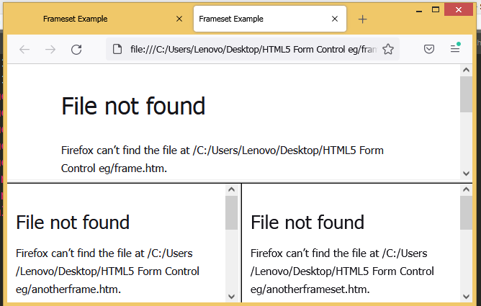
Window Relationships and Frames Example
<html>
<head>
<title>Frameset Example</title>
</head>
<frameset rows=”160,*”>
<frame src=”frame.htm” name=”topFrame”>
<frameset cols=”50%,50%”>
<frame src=”anotherframe.htm” name=”leftFrame”>
<frame src=”yetanotherframe.htm” name=”rightFrame”>
</frameset>
</frameset>
</html>
Information Technology Supporting and Maintenance

Slide 8
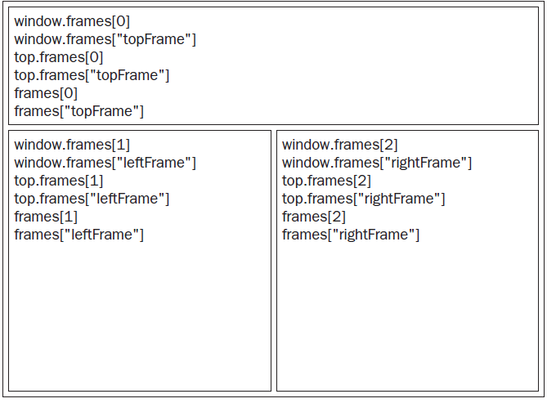
Window Relationships and Frames Con’t
Information Technology Supporting and Maintenance

Slide 9
Window Position
The position of a window object may be determined and changed using various properties and methods.
Eg:
//move the window to the upper-left coordinate
winow.moveTo(0, 0);//the x and y coordinates to move
//move the window down by 100 pixels
window.moveBy(0,100); //the number of pixels to move
//move the window to position (200, 300)
window.moveTo(200, 300);
//move the window left by 50 pixels
window.moveBy(-50, 0);
Information Technology Supporting and Maintenance

Slide 10
Window Size
The different properties can be used to determine the size of the browser window (the browser view, NOT including toolbars and scrollbars).
For Internet Explorer, Chrome, Firefox, Opera, and Safari:
window.innerHeight - the inner height of the browser window
window.innerWidth - the inner width of the browser window
For Internet Explorer 8, 7, 6, 5:
document.documentElement.clientHeight
document.documentElement.clientWidth
or
document.body.clientHeight
document.body.clientWidth
Information Technology Supporting and Maintenance

Slide 11
Window Size Example
Eg:
//resize to 100 x 100
window.resizeTo(100, 100); //same dimension
//resize to 200 x 150
window.resizeBy(100, 50); //differences
//resize to 300 x 300
window.resizeTo(300, 300);
Information Technology Supporting and Maintenance

Slide 12
Navigating and Opening/Close Windows
A popup window is one of the oldest methods to show additional document to user.
Most modern browsers are configured to open url in new tabs instead of separate windows.
window.open(“http://www.wrox.com/”, “topFrame”);
window.close( );
Information Technology Supporting and Maintenance

Slide 13
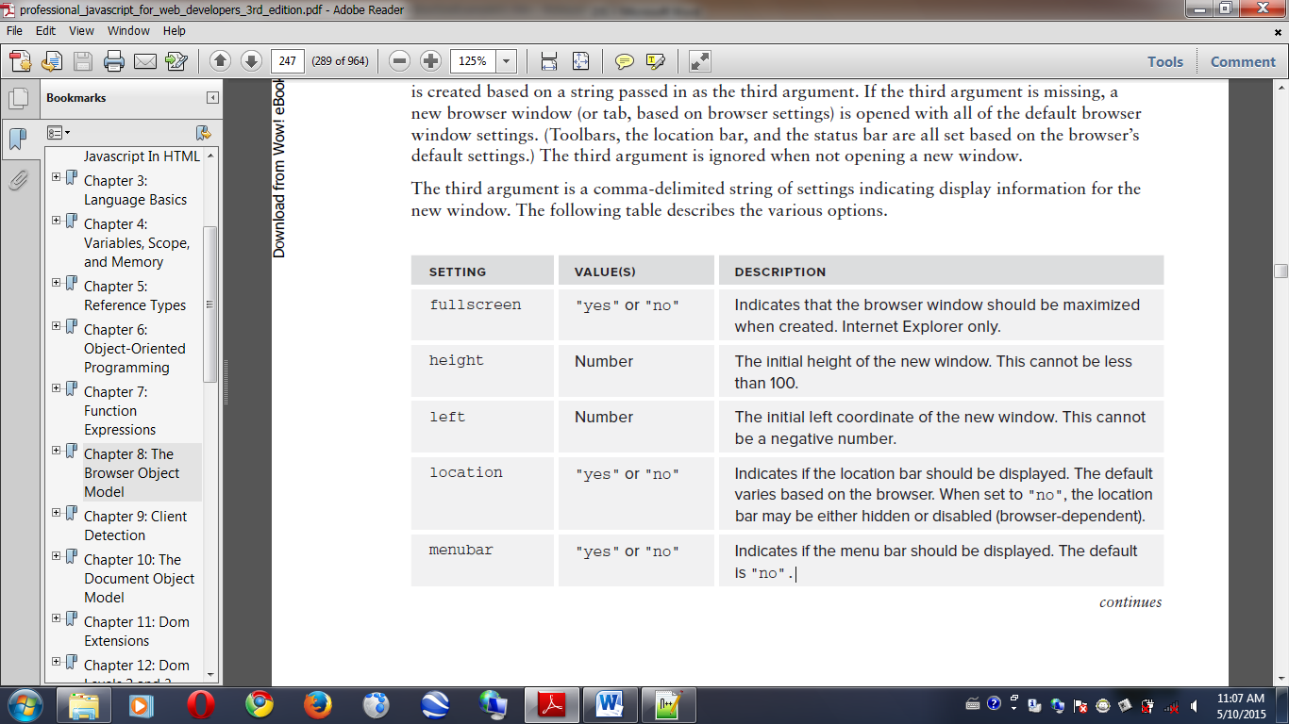
Navigating and Opening Windows Con’t
Information Technology Supporting and Maintenance

Slide 14
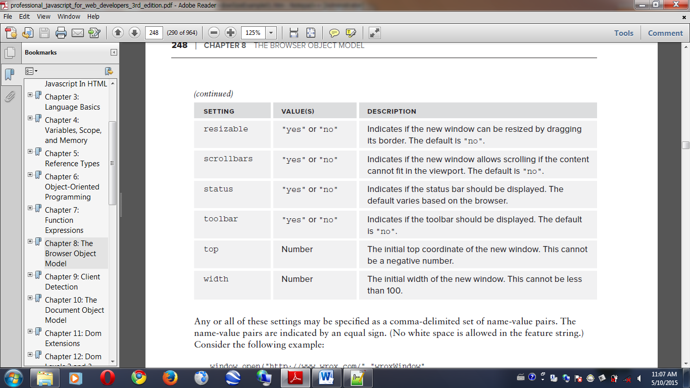
Navigating and Opening Windows Con’t
window.open(“http://www.wrox.com/”,”wroxWindow”,“height=400,width=400,top=10,left=10,resizable=yes”);
Information Technology Supporting and Maintenance

Slide 15
TimeOuts
Timeouts execute some code after a specified amount of time
intervals execute code repeatedly, waiting a specific amount of time in between each execution.
setTimeout(functioon,milliseconds)
  Executes a function, after waiting a specified number of milliseconds.
  1 second → 1000miliseconds
Eg:
setTimeout(function() {
alert(“Hello world!”);
}, 1000);
Information Technology Supporting and Maintenance

Slide 16
TimeOuts Con’t
clearTimeout() method
The clearTimeout() method stops the execution of the function specified in setTimeout().
The clearTimeout() method uses the variable returned from setTime():
Syntax:
clearTimeout(timeoutVariable)
Eg:
var timeoutId = setTimeout(function() {
alert(“Hello world!”);},1000);
clearTimeout(timeoutId);
Information Technology Supporting and Maintenance

Slide 17
Interval
Same as setTimeout(), but repeats the execution of the function continuously
Syntax:
setInterval(function, millisecconds)
Eg:
setInterval(function() {
alert(“Hello world!”);},1000);
Information Technology Supporting and Maintenance

Slide 18
Interval Con’t
Same as clearTimeout() Method
Syntax:
clearInterval(intervalName);
Eg:
var intervalId=setInterval(function() {
alert(“Hello world!”);},1000);
clearInterval(intervalId);
Information Technology Supporting and Maintenance

Slide 19
System Dialogs
Method to open a new window with some parameters
Method | Description
Window.alert() | Display alert box with OK button
Window.confirm() | Displays a confirmation dialog box with OK and Cancel button
Window.prompt() | Displays a prompt dialog box to get user input
Information Technology Supporting and Maintenance
Notes:
ဒီ slide မှာတော့ window ကို open လုပ်တဲ့ method အချိုကို table 2 နဲ့ဖော်ပြထားပါတယ်။
Window.alert ( ) သည် OK ခလုတ်ဖြင့် သတိပေးချက်ဘောက်စ်ကို ပြသပါသည်။
Window.confirm ( ) သည် OK နှင့် Cancel ခလုတ်ပါရှိသော အတည်ပြုချက် ဒိုင်ယာလော့ခ်ဘောက်စ်ကို ပြသပါသည်။
Window.prompt ( ) သည် အသုံးပြုသူထည့်သွင်းမှုရယူရန် ပေါ်လာသော ဒိုင်ယာလော့ဂ်ဘောက်စ်ကို ပြသပါသည်။

Slide 20
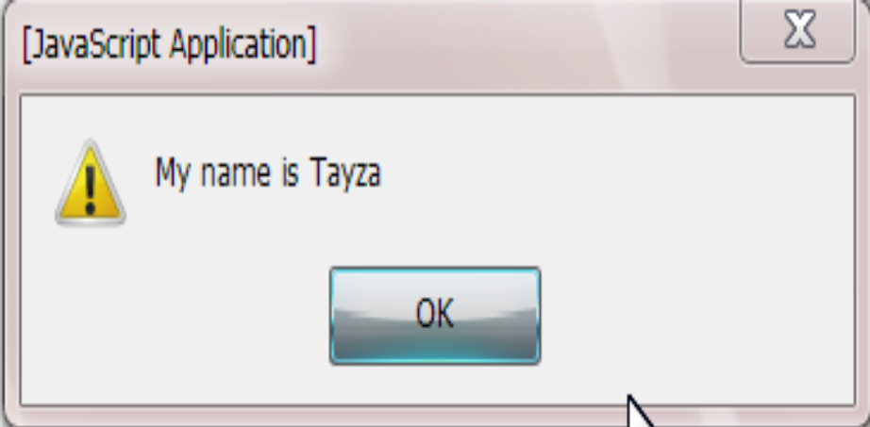
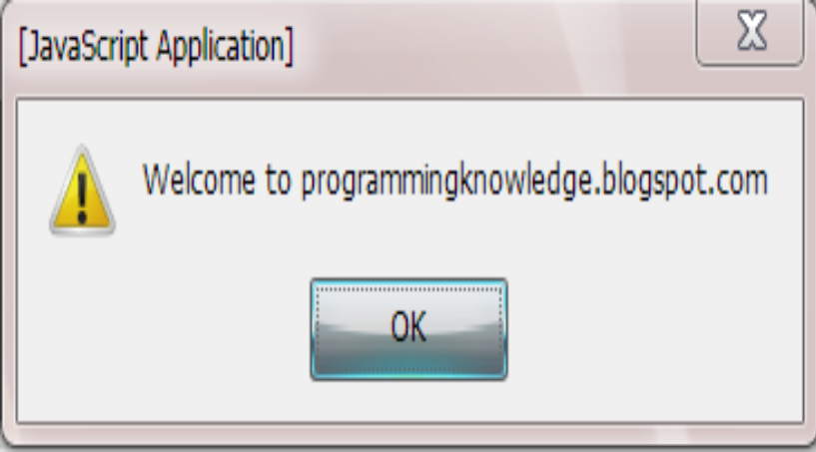
alert () Method
<html><head><title>Alert</title></head>
<body><script type="text/javascript">
alert("My name is Tayza");
window.alert("Welcome to programmingknowledge.blogspot.com");
</script></body></html>
Result:
Information Technology Supporting and Maintenance
Notes:
ဒီ slide ကတော့ အပေါ်က slide number 17 တွင်ပြထားသော Window.alert ( ) code commend ကို ဥပမာတစ်ပုဒ်နဲ့သုံးပြထားပါတယ်။

Slide 21
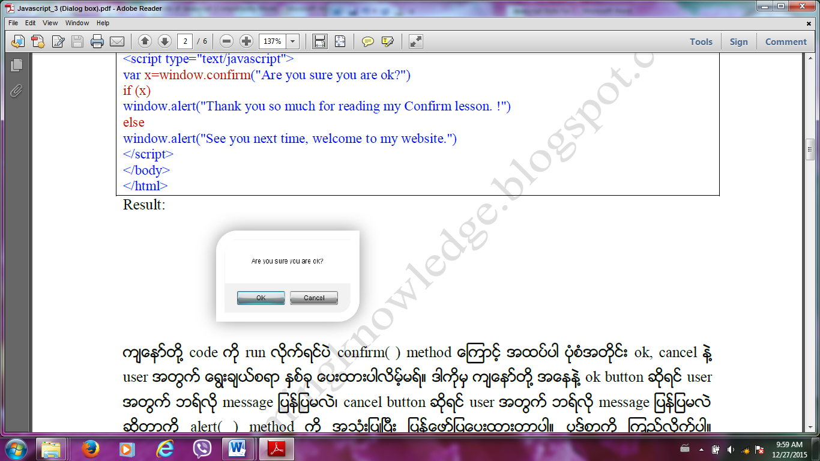
confirm( ) Method
<html>
<head>
<title>CONFIRM</title></head>
<body><script type="text/javascript">
var x=window.confirm("Are you sure you are ok?");
if (x)
window.alert("Thank you so much for reading my Confirm lesson. !") ;
else
window.alert("See you next time, welcome to my website.") ;
</script></body></html>
Information Technology Supporting and Maintenance

Slide 22
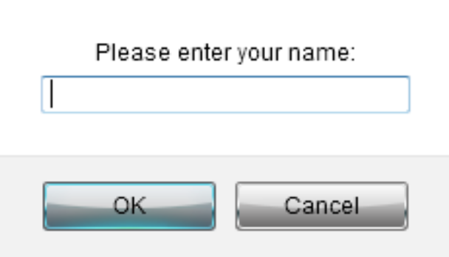
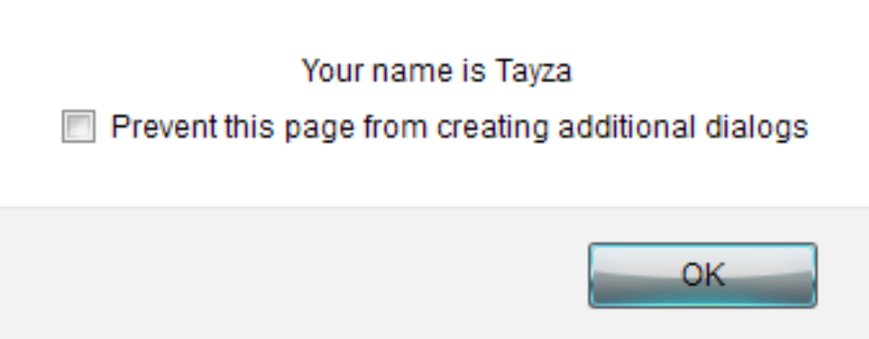
prompt( ) Method
<html>
<head><title>Prompt Dialog box</title></head>
<body><script type="text/javascript">
var y=window.prompt("Please enter your name:");
if(y) window.alert(“your name is ” +y);
else window.alert("You are Nameless man.");
</script></body></html>
Result:
Information Technology Supporting and Maintenance
Notes:
ဒီ slide ကတော့ အပေါ်က slide number 17 တွင်ပြထားသော window.prompt() နှင့် window.print()
code commend ကို ဥပမာတစ်ပုဒ်နဲ့သုံးပြထားပါတယ်။

Slide 23
print( ) Method
<html>
<head><title>Window Printing</title></head>
<body>
<script type="text/javascript">
if(confirm("Are you sure to print?")){
window.print();
}
else{
alert("Sorry, Not printing..."); }
</script>
</body></html>
Information Technology Supporting and Maintenance

Slide 24
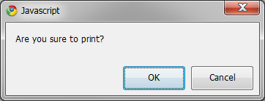
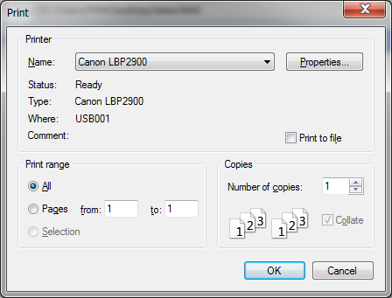
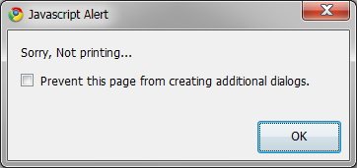
print ( ) Method Output
Information Technology Supporting and Maintenance
Notes:
ဒီ slide ကတော့ အပေါ်က slide number 21 ကပုဒ်စာကို run လိုက်ပါကပေါ်လာသော dialogs boxes များကိုပြထားခြင်းဖြစ်ပါတယ်။

Slide 25
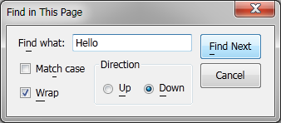
find( ) Method
<html><head><title>Window Printing</title></head>
<body>
<script type="text/javascript">
if(confirm("Do you want to find any word?")){
window.find( );
}else{
alert("Sorry, Not printing...");
}</script></body></html>
Information Technology Supporting and Maintenance
Notes:
ဒီ slide ကတော့ အပေါ်က window.find( ) code commend ကို အသုံးပြုပြီး စာလုံးတစ်လုံးရှာဖွေ ပုံကို ဥပမာတစ်ပုဒ်နဲ့သုံးပြထားပါတယ်။

Slide 26
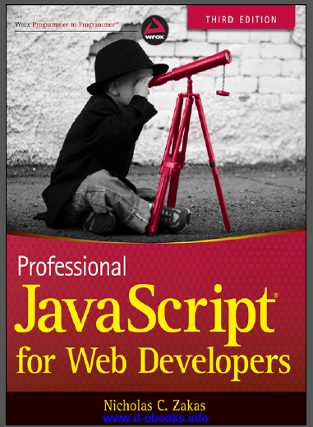
References
“PROFESSIONAL JavaScript for web Developers”
Third Edition
Zichalos C.Zakas
Nicholas, “Professional JavaScript for Web Development”
Colleen van Lent Ph.D, “INTERACTIVITY WITH JAVASCRIPT”
Information Technology Supporting and Maintenance

Slide 27
Thank You
1
Information Technology Supporting and Maintenance

